Slide 1

Exit Exam
Preparation/Practice
Application
Team G
Presented by: Garrett Johnson, Chris Anthony, Jose Soto, Sandesh Pathak

Slide 2

Description of Problem
Software to assist students preparing for the MSU Computer Science Exit Examination
Practice Topics
Practice Exam

Slide 3
Requirements
Created with Python
JSON required for information storage
Standalone
Save and Load Sessions
Backup/rephrased question
Explanation assistance for each question

Slide 4





Development Tools
Github
VSCode
Replit
Draw.io
Google Slides and Docs

Slide 5
Team Organization
Scrum Meetings: 5 - 30 minutes after class and on weekends
Discord for communication: In times where nobody is available, messages would be left in discord to be viewed later, important message would be pinned.
Garrett would lead meetings, if unavailable, Jose would take over.

Slide 6
User environment
Available for Widows, Mac, & Linux Systems
Processor: 1 GHz
Hard Disk: 1 GB
RAM: 1 GB
Display: 800x600
Input Device: Mouse

Slide 7
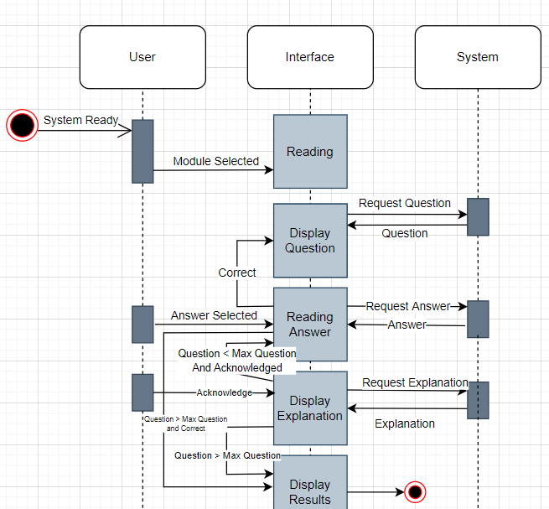
UML Sequence Diagram

Slide 8
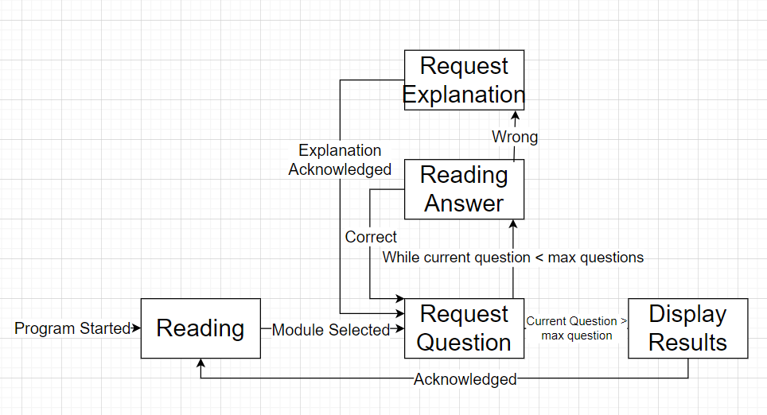
UML State Diagram

Slide 9
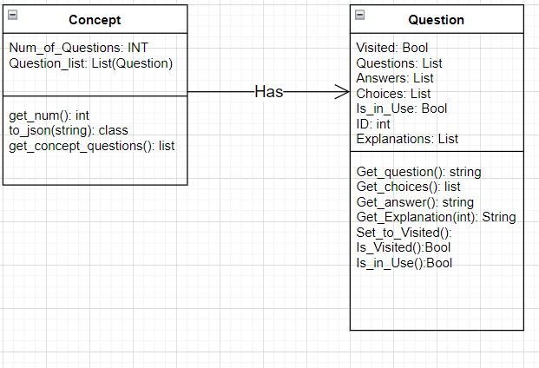
Class Diagram

Slide 10
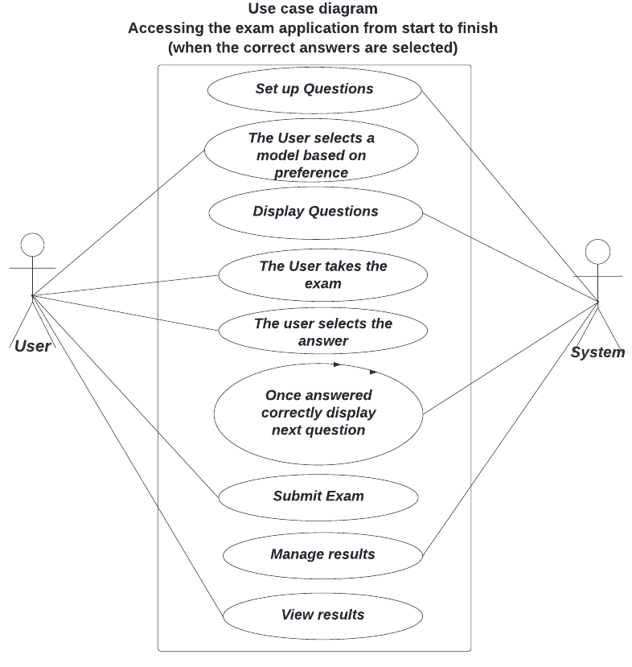
Use Case Diagram 1

Slide 11
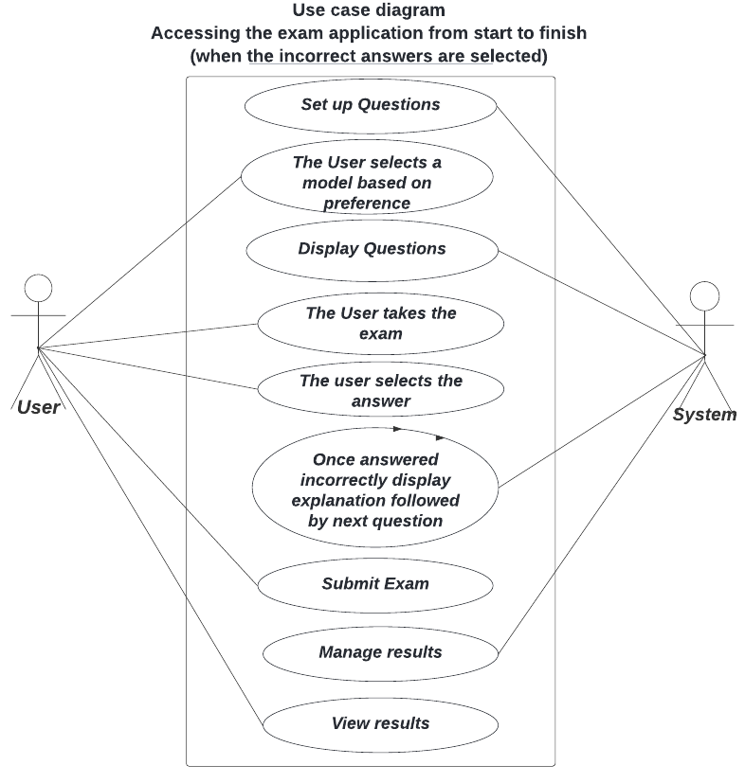
Use Case Diagram 2

Slide 12
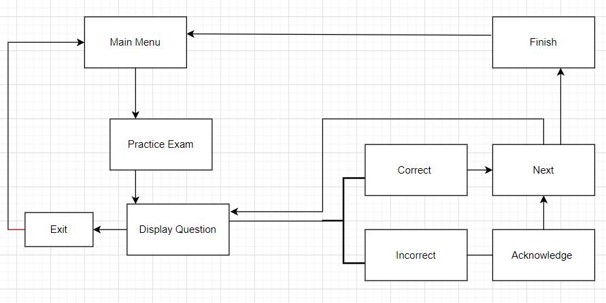
User Interface Design /Navigation
Diagram
.

Slide 13

Possible Future Project Ideas
Include randomization among questions
Add Timed Exam mode
Add Topic-based mode
Show Progress in each subject
Additional sound effects (Maybe)
Hint System (Maybe)
Mobile Compatibility

Slide 14
Conclusion
Application will:
Be easy to use
Provide Information on multiple Computer Science topics
Be a useful tool to prepare for an exit exam

Slide 15


